Slide 1
CASE STUDY
AIRLIFT
By Warda Raees
March 2022

Slide 2
PROBLEM STATEMENT
-- Store Operators at each express warehouse are responsible to pick and pack
orders that land at a particular warehouse. With the current optimizations, a store operator can
process 70 orders in an 8-hour shift. In order to ensure that warehouses have capacities of
store ops matched to the orders for the upcoming week, we need to ensure that we can
estimate the number of orders that we will deliver in the upcoming week.
● Forecast daily orders for the next week (9th November, 2021 - 15th November, 2021)
for both, EW1 and EW2.
● Suggest the number of store operators we should have at each of the aforementioned
Express Warehouses.

Slide 3
Following questions would be answered in the next slides:
1. Explore the data and share your findings. Do you see any interesting patterns?
2. Forecast daily orders for the next week (9th November, 2021 - 15th November, 2021) for both, EW1 and EW2.
3. Suggest the number of store operators we should have at each of the Express Warehouses.
4. Explain your choice of forecasting model used to solve Problem 2. Suggest what other metrics or features can be used to improve the demand forecasting model.
5. How can you measure forecasting accuracy of a forecasting model?

Slide 4
TOOLS & TECHNOLOGIES USED
BigQuery Data Warehouse – SQL(Data transformation)
Microsoft Power BI – Data Visualization
Microsoft Excel – Forecasting

Slide 5
METHODOLOGY
First, i import airlift orders dataset to BigQuery data warehouse in the Google Cloud Platform.
After that, i transform the data according to the problem statement in order to analyze it & getting interesting insights by using SQL queries.
Then, i export the transformed data to Microsoft Power BI in order to visualize it.
Then i performed forecasting using Linear Regression through =FORECAST.LINEAR(B57,C2:C56,$B$2:$B$56) function and found number of store operators with the help of =ROUNDUP(DIVIDE(C2,70)) in Microsoft Excel.
Then i analysed the forecasting plots of Regression Analysis in MS Excel.
I performed forecasting for warehouse EW1 & EW2 separately.

Slide 6
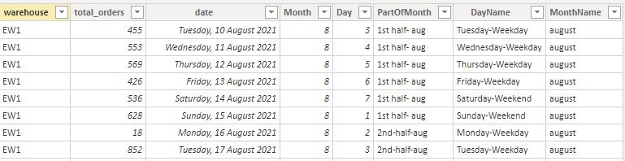
Transformed Dataset After Performing SQL Queries

Slide 7
Sharing Interesting Insights From the Transformed Airlift Orders Dataset
Visit https://bit.ly/3DbOFoW to see the clear view of the visualization of the dashboard visuals.

Slide 8
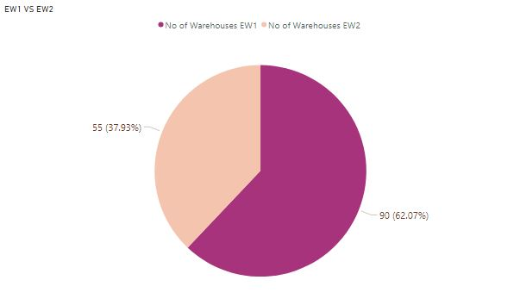
Total No. Of Orders Taken By EW1 & EW2

Slide 9
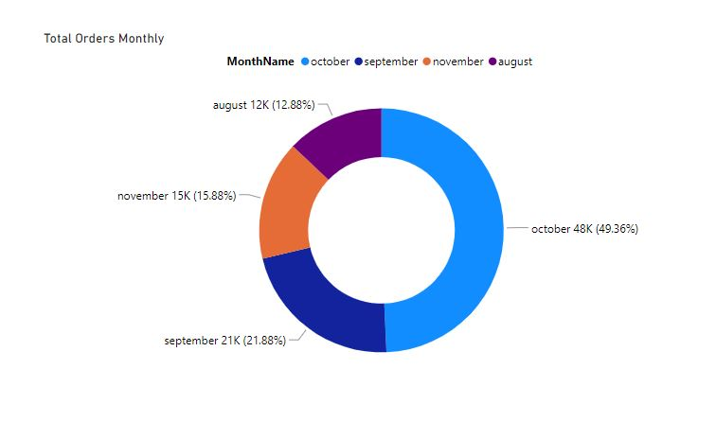
Total Orders Monthly
Highest orders(49%) occurred in the month of october.
There is only 12.8% orders occurred in the whole month of august.
Whereas, only in the first week of november there are 15.8% orders.

Slide 10
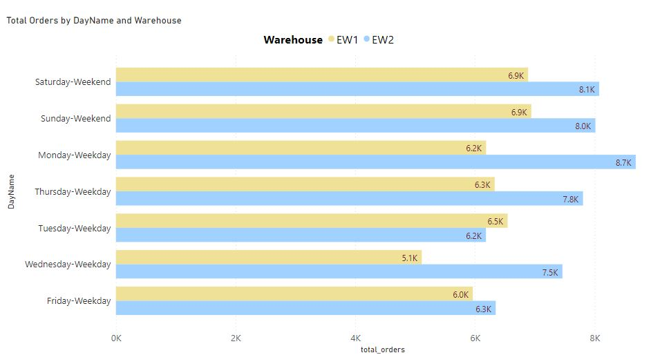
Total Orders By Day And Warehouse

Slide 11
Total Orders By Day And Warehouse
Warehouse EW2 has more orders than EW1 on weekdays and weekends both.
Highest orders take place on monday for EW2 & on weekend for EW1.
Fewest orders take place on wednesday for EW1 & on tuesday for EW2.
Overall, greater number of orders takes place on weekend in both warehouses.

Slide 12
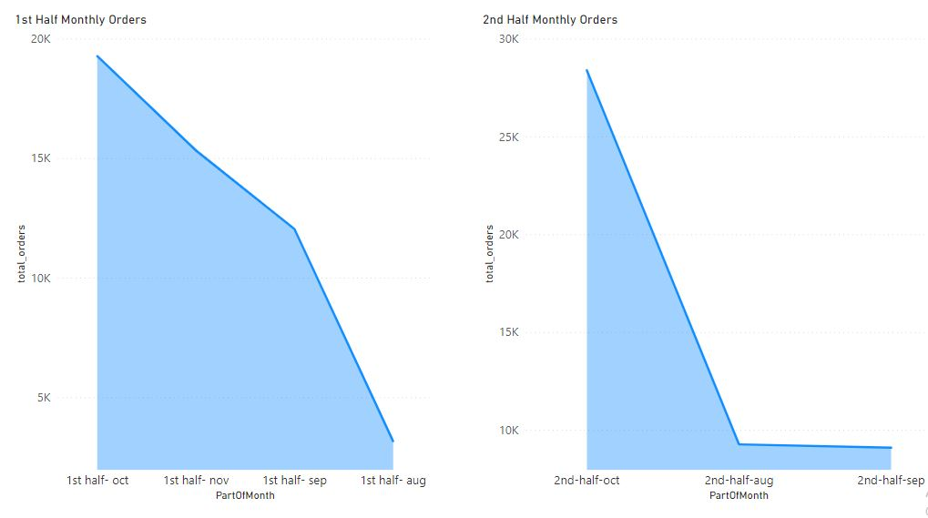
Total Monthly Orders By Part Of Month

Slide 13
Total Monthly Orders By Part Of Month
October being on the top, for greater number of orders in the first and second half of the month.
August has fewest orders in the first and second half in comparison of other months.
Moderate number or orders take place in first half of september but decreased drastically in the second half.
First half of november is having large number of orders but less than october.

Slide 14
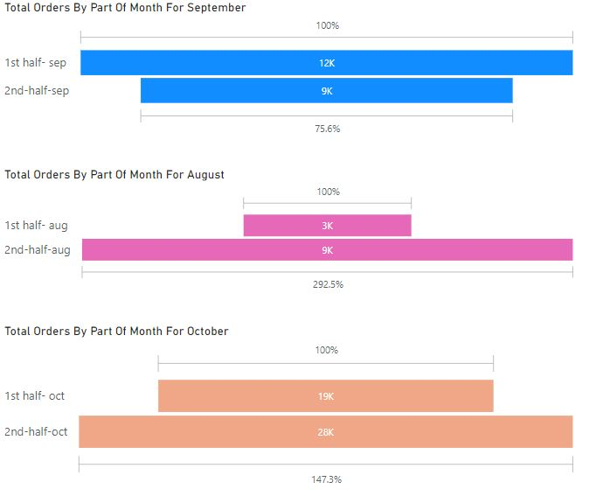
Total Orders For Each Month By Part Of Month

Slide 15
Total Orders For Each Month By Part Of Month
First half of august has 6k less orders than in second half.
First half of october has 9k less orders than in second half.
First half of september has 3k more orders than in second half.

Slide 16
Forecasting
Daily Orders For The Next Week (9th November, 2021 - 15th November, 2021)
By Performing Regression Analysis

Slide 17
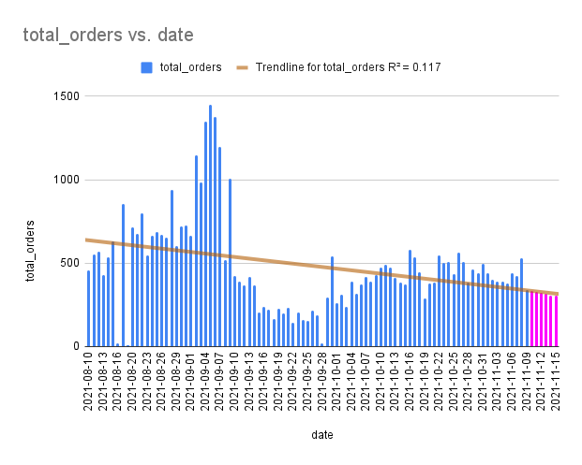
For EW1 Warehouse
In the next week of november orders will be slightly decreased linearly than usual.

Slide 18
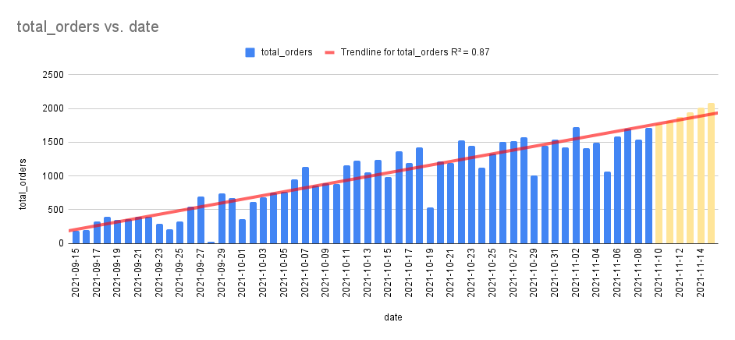
For EW2 Warehouse
In the next week of november orders will be increased in a greater number than usual.

Slide 19
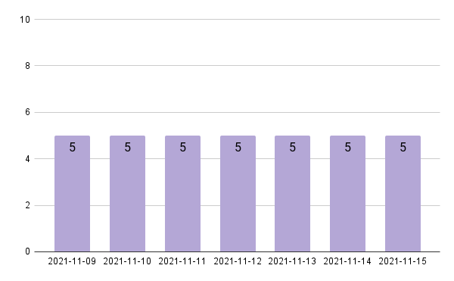
No. Of Operators Required For EW1 For The Upcoming Week
As number of orders would be decreased, therefore, a low number of operators would be required for the upcoming week.

Slide 20
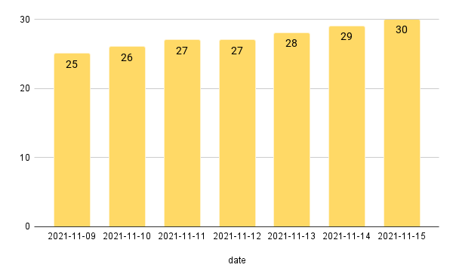
No. Of Operators Required For EW2 For The Upcoming Week
As number of orders would be increased, therefore, operators required would also be increased.

Slide 21
Forecasting Model
If the forecasting is being performed on python using machine learning then the accuracy would be checked by Mean Absolute Error.
For building a good forecasting model using ML, greater number of data points are required.
When number of data points are less, then MS Excel is good choice for forecasting.

Slide 22
Features That Can Be Used To Improve The Demand Forecasting Model.
Timings for the placing of orders i.e (morning, afternoon, evening).
Warehouse locations and address of customers who are ordering.
Feedback from customers regarding the ordered items
Age group of customers.
Gender of customers.

Slide 23
Measure Forecasting Accuracy Of The Forecasting Model
In order to measure forecasting accuracy of the model, actual value of orders occurred is required.
I will take the absolute value of (Forecast-Actual), which is the forecast error and divide by the larger of the forecasts or actuals.
Lesser the forecast error, the more accurate our model is.

Slide 24
THANK YOU

